Slide 1
Comparing R, SAS, and Python Tools
November 24, 2019
Scenario Presentation Module 2: MIS500 Winter ‘19, Colorado State University-Global Campus, Jamia Mills, Ph.D.

Slide 2
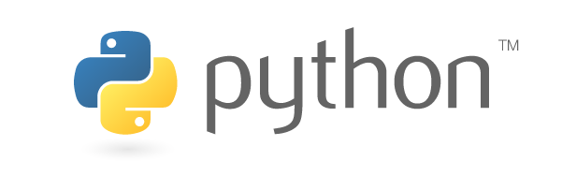
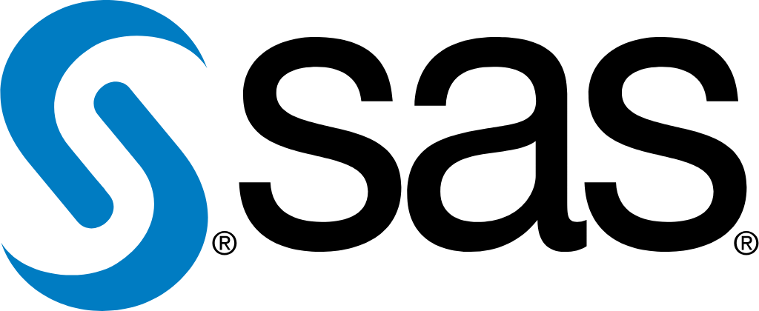

AGENDA
Source: https://www.python.org/community/logos/
Brief Historical Background
Job Perspective
Availability / Cost
Ease of usage/learning
Capabilities
Available Support
Future Outlook
Source: https://www.python.org/community/logos/
Source: https://www.python.org/community/logos/
Notes:
Today will present a comparative analysis on three different data tools: Python, R-Studio, SAS Studio.
This presentation will cover:
Brief Historical Background
Possibilities of us
Availability / Cost
Ease of usage/learning
Capabilities
Data task scenarios
Customer service support and Community
Future Outlook

Slide 3
Brief History on Python, R, & SAS
Python
R Studio
SAS Studio
First released in 1991, Python 0.9.0 was inspired by ABC programming (Wolfe, 2019)
Version 3.0 released in 2008
Current Version is 3.8
Python has been an inspiration for many other coding languages such as Ruby, Cobra, Boo, CoffeeScript ECMAScript, Groovy, Swift Go, OCaml, Julia etc.
Relying on R language developed in the 1990’s, RStudio IDE 0.92.23 was first released in 2011.
Current Version 1.2.5019-6 released in 2019
Recent changes to R studio include new language integrations with SQL, Python, D3, and more (RStudio Support, 2019).
SAS was first released in the 1970’s.
SAS Studio, 9.4, was first released in 2013.
Current version is SAS 9.4M6 released Nov. 2018
The SAS Web Server is now based on Apache Open Source HTTP server, and supports Federal Information Processing Standards (FIPS) compliance (SAS, n.d.).
Notes:
Each tool has a long history, using slightly different programming languages. The biggest change in Python 3.8 is the introduction of assignment expressions (Hjelle, G. 2019). Using R language, R studio’s latest upgrades include added integrations. The oldest of tools is SAS, who now notably supports FIPS compliance.
References:
RStudio Support, (2019).
RStudio. (n.d.)
SAS Institute, Inc. (n.d.)
SAS Institute, Inc. (2019).

Slide 4
Possibilities with Python, R, & SAS
Python
R Studio
SAS Studio
Web Development
Scientific & Numeric Computing
Machine Learning
Browser Automation
Statistical analysis
Interactive Web Applications
Database Connection
Machine Learning
Advanced Analytics
Business Intelligence
Data Management
Predictive Analytics
Notes:
Python is diverse, easy to use, and it’s taking over data science and development spaces. (Zola, 2017).
R Studio has shifted from just a data analysis tool, to a multi-purpose connective language. (Simply Statistics, 2019).
SAS Studio is more than capable of managing and manipulating big data, and relatively easy to learn. (SAS Support, 2019).

Slide 5
Cost of Python, R, & SAS
Python
R Studio
SAS Studio
Python is developed under an OSI-approved open source license, making it freely usable and distributable, even for commercial use.
Many Python Integrated development environment (IDE’s) are also free, open-source, so minimal investments need to be made up front.
Available in open source, and paid commercial editions for organizations not able to use AGPL software.
Paid options ranges by number of users, and server requirements.
Commercial Desktop License: 1 User/Year: $995.00
Server Pro Standard: 5 Users/Year: $4,975
Server Pro Enterprise: 10 Users/Year: $11,950
SAS/ACCESS Software: Metadata integration $3,390.00
SAS Visual Data Discover: Statistical Analysis $11,760.00
SAS Analytics Pro: Data visualization, presentation & delivery $10,010.00
Notes:
Python is an OSI-approved open source license. Many Python IDE’s are also open source, allowing Python to be used with minimal cost for the software.
R. Studio offers many open source resources, but has commercial licences. Pricing depends on the number of users, and what tools and features are added to the package. A single user can use the standard commercial license software with support for $995/year. Additional packages for 5+ users include server activation and various sessions/versions are available for approx. $5k. The enterprise edition has unrestricted server activations, allowing 10 users access for $11,950. Additional users, or integrations will cost more.
SAS software pricing depends on the need of the software. Pricing varies from $3,390 to over $10k, depending on what you need the software to do.
Sources:
https://www.sas.com/store/products-solutions/cSoftware-p1.html
https://rstudio.com/pricing/individual-products/

Slide 6
Ease of Use for Python, R, & SAS
Python
R Studio
SAS Studio
Python is among the top 5 coding languages to use, because it’s logical (Pramanick, n.d.)
Flexible, simple, easy to learn, and offers an intuitive syntax (Savaram, n.d.).
R is more difficult to learn, and requires proficiency, and basic programming orientation. (Savaram, n.d).
R outshines for graphical capabilities with packages like: Lattice, ggplot, RGIS, etc.
SAS is also simple to learn, and can be picked-up by less experienced programmers.
Notes:
Python is among the top 5 easiest to lanugages to use. It’s object based, offers intuitive syntaxes, and has an extensive community for support. R Studio can be more difficult to learn for someone new to programming. Savaram (n.d.) claims SAS studio to be the simplist language to learn, and by anyone without prior programming language experience.

Slide 7
Capabilities & Available Support For
Python, R, & SAS
Python
R Studio
SAS Studio
Python is an all-around tool for data, visualizations, statists, and more through open-source tools
Python offers multiple graphing libraries, and has massive community run libraries
NumPy
Pandas
SciPy, etc.
Python Software Foundation is an organization devoted to advancing open source technology related to the Python programming language.
Typically used for statistical analysis, R is able to connect with nearly all databases
R features additional capabilities in web applications, and video game interfaces through NES looking Shiny apps (Simply Statistics, 2019).
SAS business support features excellent support for unique scenarios, and where you can’t be experimenting.
SAS can be used for advanced analytics, including predictive, and data management.
SAS software can be used through both a graphical interface, and the SAS programming language, or Base SAS.
Notes:
Python is capable of nearly anything with the right tools, concepts, and programmer capabilities, and is largely open source (Osetskyi, V. 2018). R is diverse, and capable, and also has the benefit of multiple open source resources. SAS offers excellent support to paid customers, but may not have as many open source resources.
Osetskyi, V. (2018). AI programming: 5 most popular AI programming languages. DZone. Retrieved from https://dzone.com/articles/ai-programming-5-most-popular-ai-programming-langu
SAS Institute, Inc. (n.d.). SAS studio: Help center. SAS Institute, Inc. Retrieved from https://support.sas.com/software/products/sas-studio/faq/SAS_whatis.htm
Simply Statistics (2019). 10 things R can do that might surprise you. Simply Statistics. https://simplystatistics.org/2019/03/13/10-things-r-can-do-that-might-surprise-you/

Slide 8
Future Outlook of Python, R, & SAS
Python
R Studio
SAS Studio
Python remains at the top of the list as a favorite programming language, and easy to use. It continues to support developments at a growing rate
If anything Python may be headed to new heights with AI involvement (Anurag, 2019)
Recently announced future advancements:
Working towards a Security Assertion Markup Language (SAML)
Job Launcher and Git integrations
Customizable views into content
more..
Modern IDE
More alignment / collaboration between SAS Studio (Browser) and SAS Enterprise Guide (Desktop) (Hemedinger, 2018).
Notes:
Python is not going anywhere, and stands to be the most useful, resourceful, and cost efficient tool available. RStudio may be used for machine learning, and working with big data, and capable of creating complex data visualizations (Kopf, 2017). They benefit from an open source community, though it may not be as robust as Python. SAS is a great tool for data analysis, though it because it was developed for that specific use, and becaise it’s not open source, it doesn’t share a large community who add new tools like Python, or R do (Kopf, 2017). It’s also the most expensive option.

Slide 9
References
Anurag, (2019). Future of Python in the industry. New Generation Applications Pvt Ltd. Retrieved from https://www.newgenapps.com/blog/future-of-python-in-the-industry
Hemedinger, C. (2018). A productive future for SAS enterprise guide 11. SAS Institute Inc., Retrieved from https://blogs.sas.com/content/sasdummy/2018/04/30/sas-enterprise-guide-futures/
Hjelle, G. (2019). Cool new features in Python 3.8. Real Python. Retrieved from https://realpython.com/python38-new-features
Kopf, D. (2017). If you want to upgrade your data analysis skills, which programming language should you learn? Quartz. Retrieved from https://qz.com/1063071/the-great-r-versus-python-for-data-science-debate/
Neil, T. (2019). Future of Python language: Bright or dull? Hackernoon. Retrieved from https://hackernoon.com/future-of-python-language-bright-or-dull-uv41u3xwx
Osetskyi, V. (2018). AI programming: 5 most popular AI programming languages. DZone. Retrieved from https://dzone.com/articles/ai-programming-5-most-popular-ai-programming-langu
Pramanick, S. (n.d.). History of Python. Geeks for Geeks. Retrieved from https://www.geeksforgeeks.org/history-of-python/
RStudio. (n.d.) About RStudio. RStudio. Retrieved from https://rstudio.com/about/
RStudio Support (2019). Rstudio release history. Rstudio. Retrieved from https://support.rstudio.com/hc/en-us/articles/200716783-RStudio-Release-History

Slide 10
References
SAS Institute, Inc. (n.d.). Company overview. SAS Institute, Inc. Retrieved from https://www.sas.com/en_us/company-information/profile.html
SAS Institute, Inc. (2019). Overview of SAS 9.4. SAS Institute, Inc. Retrieved from https://go.documentation.sas.com/?cdcId=pgmsascdc&cdcVersion=9.4_3.5&docsetId=whatsnew&docsetTarget=n17cszme3e52b4n1ooe3710fnuec.htm&locale=en
SAS Institute, Inc. (n.d.). SAS studio: Help center. SAS Institute, Inc. Retrieved from https://support.sas.com/software/products/sas-studio/faq/SAS_whatis.htm
Savaram, R. (n.d.). Python vs SAS vs R. Mind Mijix. Retrieved from https://mindmajix.com/python-vs-sas-vs-r
Simply Statistics (2019). 10 things R can do that might surprise you. Simply Statistics. https://simplystatistics.org/2019/03/13/10-things-r-can-do-that-might-surprise-you/
Wolfe, J. (2018). A brief history of Python. Medium. Retrieved from https://medium.com/@johnwolfe820/a-brief-history-of-python-ca2fa1f2e99e
Zola, A. (2017). Some cool things you can do with Python. Intersog. Retrieved from https://intersog.com/blog/some-cool-things-you-can-do-with-python/

